Slide 1
Image Segmentation
Reference : Digital Image Processing, 3rd edition, Gonzalez & Woods, Prentice Hall, 2009

Slide 2
Preview
Segmentation subdivides an image into its constituent regions or objects. The level to which the subdivision is carried depends on the problem being solved.

Slide 3
Preview
Image segmentation algorithms generally are based on one of two basic properties of intensity values : discontinuity and similarity. In the first category, the approach is to partition an image based on abrupt changes in intensity, such as edges in an image. The principal approaches in the second category are based on partitioning an image into regions that are similar according to a set of predefined criteria. Thresholding, region growing, and region splitting and merging are examples of methods in this category.

Slide 4
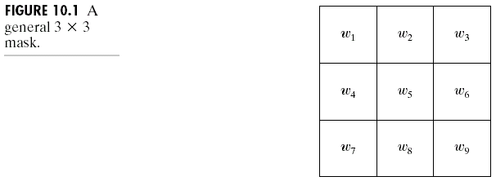
Detection of Discontinuities
There are several techniques for detecting the three basic types of gray level discontinuities in a digital image : points, lines and edges.
The most common way to look for discontinuities is to run a mask through the image.

Slide 5
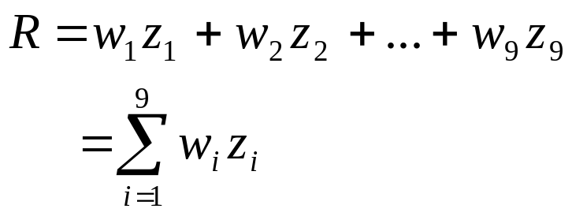
Detection of Discontinuities
The response of the mask at any point in the image is given by :
where z_{i} is the gray level of the pixel associated with mask coefficient w_{i}.
The response of the mask is defined with respect to its center location.

Slide 6
Point Detection
A point has been detected at the location on which the mask is centered if |R|≥T, where T is a nonnegative threshold.
The idea is that an isolated point (a point whose gray level is significantly different from its background and which is located in a homogeneous or nearly homogeneous area) will be quite different from its surroundings, and thus be easily detectable the type of mask in figure 10.2.a.
The mask coefficients sum to zero, indicating that the mask response will be zero in areas of constant gray level.

Slide 7
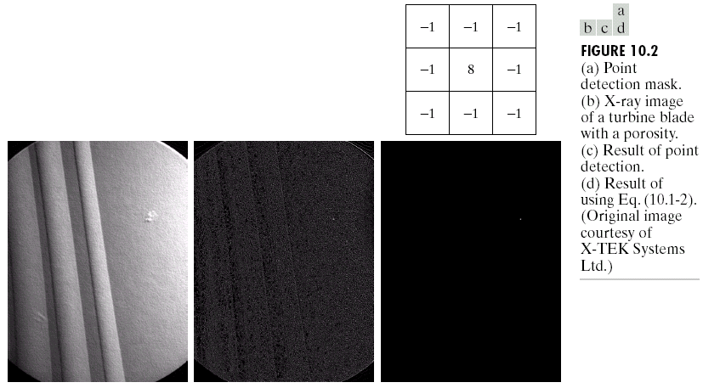
Point Detection

Slide 8
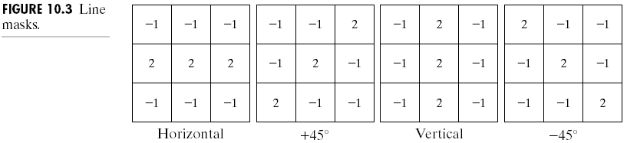
Line Detection
If the first mask were moved around an image, it would response more strongly to lines (one pixel thick) oriented horizontally.
The coefficients in each mask sum to zero, indicating a zero response from the masks in areas of constant gray level.

Slide 9
Line Detection
Let R1, R2, R3, and R4, denote the responses of the masks. Suppose that the four masks are run individually through an image. If, at a certain point in the image, |Ri|>|Rj|, for all j≠i, that point is said to be more likely associated with a line the direction of mask i.
If we interested in detecting lines in a specified direction, we could use the mask associated with that direction and threshold its output.

Slide 10
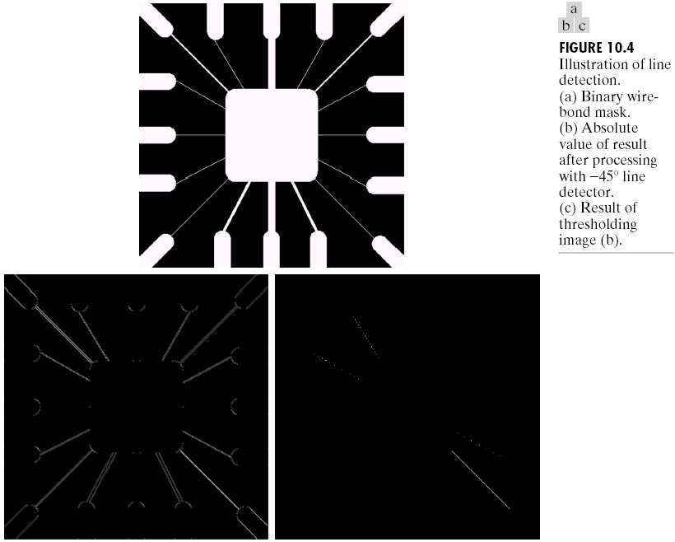
Line Detection

Slide 11
Edge Detection
An edge is a set of connected pixels that lie on the boundary between two regions.
An ideal edge in fig 10.5.a is a set of connected pixels (in the vertical direction), each of which is located at an orthogonal step transition in gray level.
In practice, optics, sampling, and other image acquisition imperfections yield edges that are blurred, with the degree of blurring being determined by factors such as the quality of the image acquisition system, the sampling rate, and illumination conditions under which the image is acquired. As a result, edges are more closely modeled as having a “ramplike” profile, such as fig 10.5.b. The thickness of the edge is determined by the length of the ramp. This length is determined by the slope, which, in turn, is determined by the degree of blurring. Blurred edge tend to be thick and sharp edges tend to be thin.

Slide 12
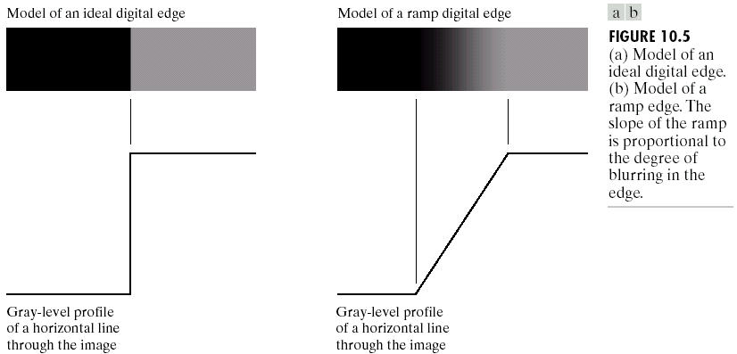
Edge Detection

Slide 13
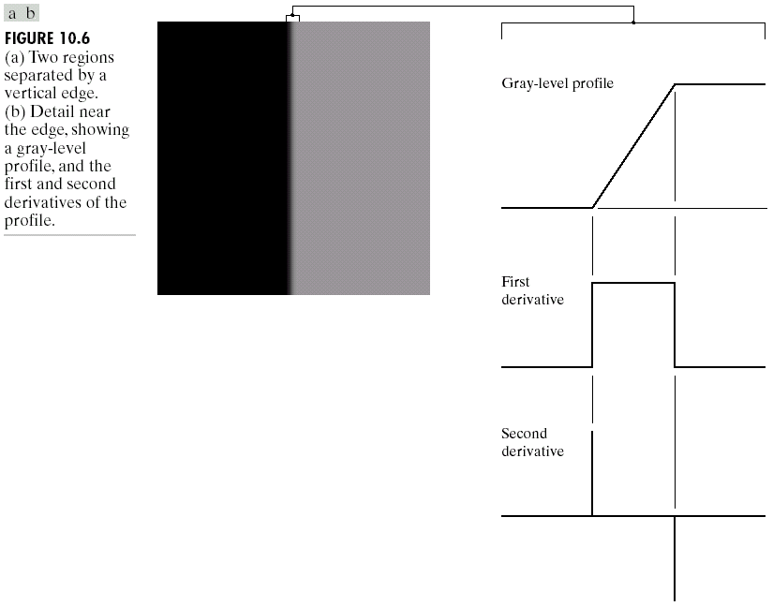
Edge Detection

Slide 14
Edge Detection
The magnitude of the first derivative can be used to detect the presence of an edge at a point in an image (i.e., to determine if a point is on a ramp).
The sign of the second derivative can be used to determine whether an edge pixel lies on the dark or light side of an edge.
The zero-crossing property (an imaginary straight line joining the extreme positive and negative values of the second derivative would cross zero near the midpoint of the edge) is quite useful for locating the centers of thick edges.

Slide 15
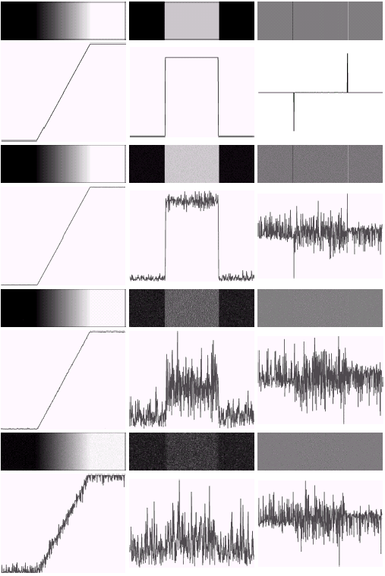

Edge Detection

Slide 16
Edge Detection
Image smoothing should be a serious consideration prior to the use of derivatives in applications where noise with levels similar to those we have just discussed is likely to be present.
To be classified as a meaningful edge point, the transition in gray level associated with that point has to be significantly stronger than the background at that point.
To determine whether a value is “significant” or not is to use a threshold.
Thus, we define a point in an image as being an edge point if its two-dimensional first order derivative is greater than a specified threshold.
A set of such points that are connected according to a predefined criterion of connectedness is by definition an edge.
The term edge segment generally is used if the edge is short in relation to the dimensions of the image.
A key problem in segmentation is to assemble edge segments into longer edges.
An alternate definition if we elect to use the second-derivative is simply to define the edge points in an image as the zero crossings of its second derivative.

Slide 17
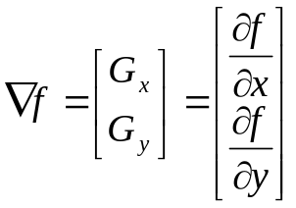

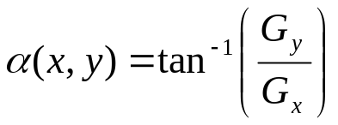
Gradient Operators
First order derivatives of a digital image are based on various approximations of the 2-D gradient. The gradient of an image f(x,y) a location (x,y) is defined as the vector :
The magnitude of the vector is :
The direction of the gradient at (x,y) is :

Slide 18
Gradient Operators
Computation of the gradient of an image is based on obtaining the partial derivatives at every pixel location.
Let the 3x3 area shown in fig 10.8.a represent the gray levels in a neighborhood of an image. One of the simplest ways to implement a first order partial derivative at point z₅ is to use Roberts cross gradient operators :
G_{x}=(z₉-z₅) and G_{y}=(z₈-z₆)
Masks of size 2x2 are awkward to implement because they do not have a clear center. An approach using masks of size 3x3.

Slide 19
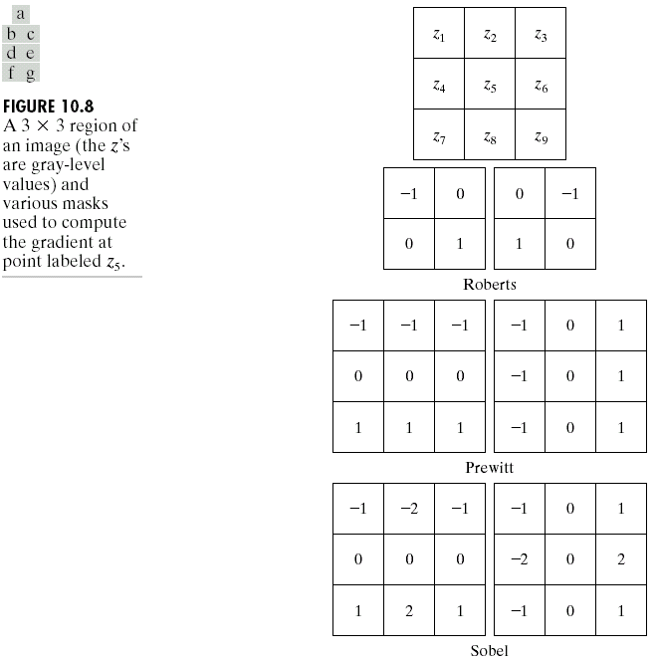
Gradient Operators

Slide 20
Gradient Operators
The coefficients in all masks sum to 0, indicating that they give a response of 0 in areas of constant gray level.
Because of simplifying computation, an approach below is used frequently to approximate the magnitude of the gradient :
∇f≈|Gx|+|Gy|
The masks give invariant results only for vertical and horizontal edges, but not isotropic (invariant to rotation)
It is possible to modify the 3x3 masks that they have their strongest responses along the diagonal directions.

Slide 21
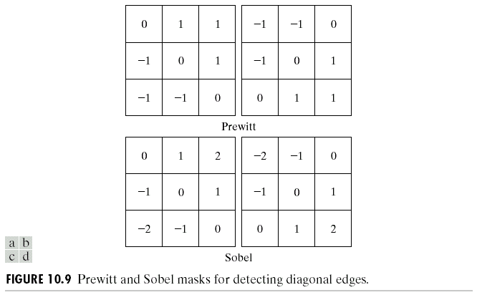
Gradient Operators

Slide 22
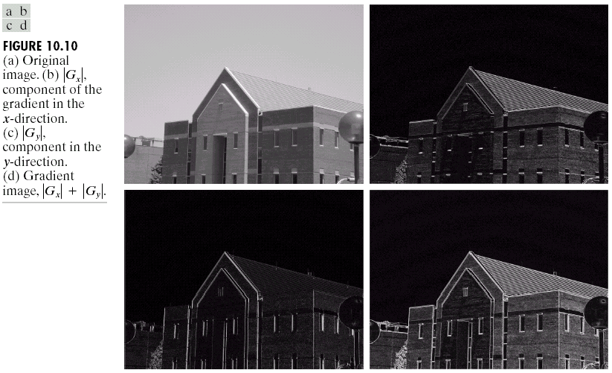
Gradient Operators

Slide 23
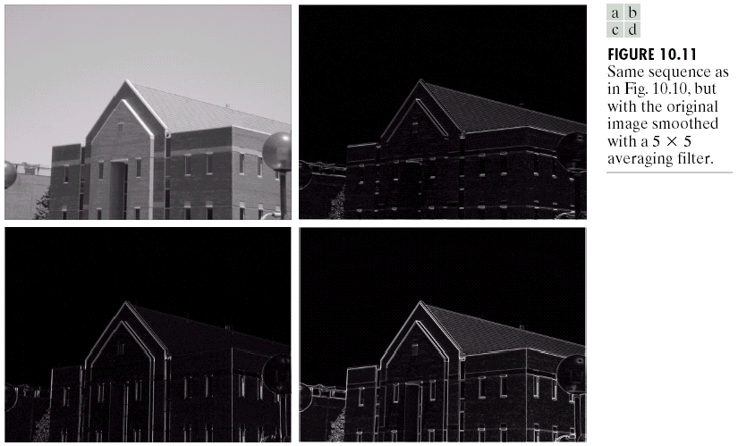
Gradient Operators

Slide 24
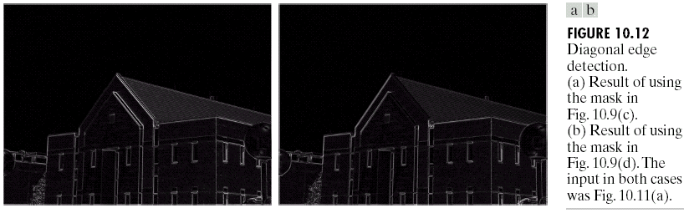
Gradient Operators

Slide 25
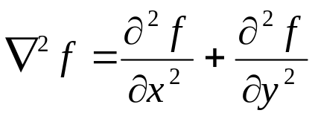
The Laplacian
The Laplacian of a 2-D function f(x,y) is a second order derivative defined as :
The Laplacian masks in fig 10.13 are isotropic for rotation increments of 90 dan 45.
The Laplacian generally is not used in its original form for edge detection because :
  As a second order derivative, the Laplacian typically is unacceptably sensitive to noise
  The magnitude of the Laplacian produces double edges, an undesirable effect because it complicates segmentation.

Slide 26
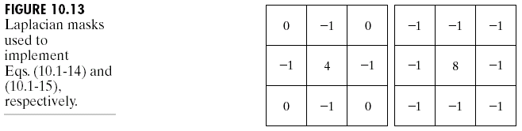
The Laplacian
The role of the Laplacian in segmentation consists of :
  Using its zero crossing property for edge location
  Using it for the complementary purpose of establishing whether a pixel is on the dark or light side of an edge

Slide 27
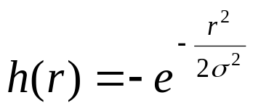
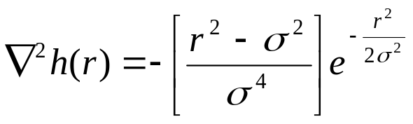
The Laplacian
In the first category, the Laplacian is combined with smoothing as a precursor to finding edges via zero crossings. Consider the Gaussian function :
where r²=x²+y² and σ is the standard deviation. Convolving this function with an image blurs the image, with the degree of blurring being determined by the value of σ. The Laplacian of h (second derivative of h with respect to r) is :
This function is commonly referred to as the Laplacian of a Gaussian (LoG).

Slide 28
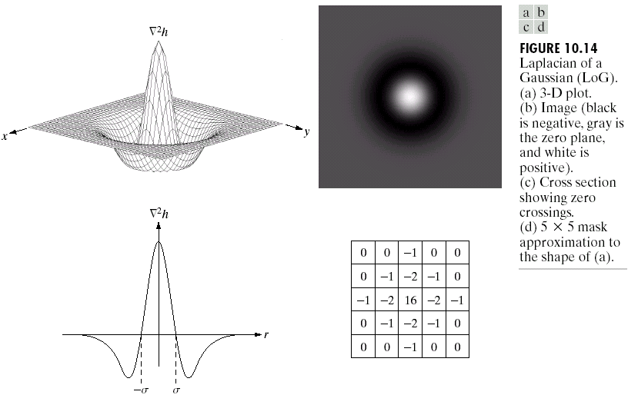
The Laplacian

Slide 29
The Laplacian
Because the second derivative is a linier operation, convolving an image with ∇²h is the same as convolving the image the Gaussian smoothing function first and then computing the Laplacian of the result.

Slide 30
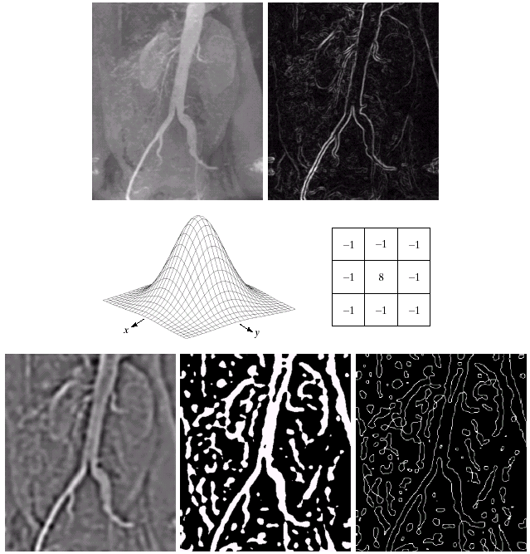
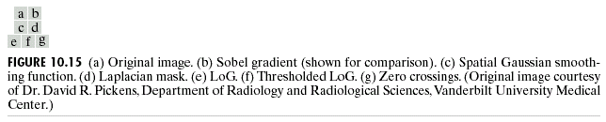
The Laplacian

Slide 31
Edge Linking and Boundary Detection
Ideally, the methods discussed in previous section should yield pixels lying only on edges. In practice, this set of pixels seldom characterizes an edge completely because of noise, breaks in the edge from non uniform illumination, and other effects that introduce spurious intensity discontinuities. Thus edge detection algorithms typically are followed by linking procedures to assemble edge pixels into meaningful edges.

Slide 32
Local Processing
One of the simplest approaches for linking edge points is to analyze the characteristics of pixels in a small neighborhood (3x3 or 5x5) about every point (x,y) in an image that has been labeled an edge point.
All points that are similar according to a set of predefined criteria are linked, forming an edge of pixels that share those criteria.
The two principal properties used for establishing similarity of edge pixels are :
  The strength of the response of the gradient operator used to produce the edge pixel
  The direction of the gradient vector

Slide 33
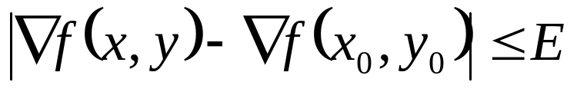

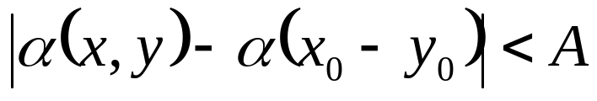
Local Processing
An edge pixel with coordinates (x0, y0) in a predefined neighborhood of (x, y) is similar in magnitude to the pixel at (x, y) if
where E is a non negative threshold.
An edge pixel with coordinates (x0, y0) in a predefined neighborhood of (x, y) has an angle (direction) similar to the pixel at (x, y) if
where A is a non negative angle threshold.
A point in a predefined neighborhood of (x, y) is linked to the pixel at (x, y) if both magnitude and direction criteria are satisfied.

Slide 34
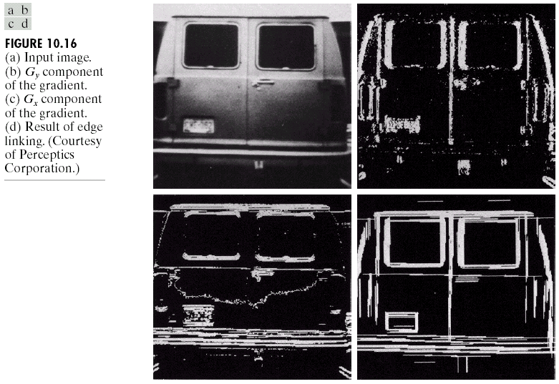
Local Processing

Slide 35
Global Processing via the Hough Transform
Points are linked by determining first if they lie on a curve of specified shape.
Given n points. We want to find subsets of these points that lie on straight lines. One possible solution is to first find all lines determined by every pair of points [n(n-1)/2 ~ n²] and then find all subsets of points that are close to particular lines [(n)(n(n-1))/2 ~ n³]. This approach is computationally prohibitive in all but the most trivial applications.

Slide 36
Global Processing via the Hough Transform
Hough [1962] proposed an alternative approach referred to as Hough Transform.
Consider a point (xi, yi) and the general straight line equation in slope intercept form, yi=a xi + b.
Infinitely many lines pass through (xi, yi), but they all satisfy the equation yi=a xi + b for varying values of a and b.
Writing this equation as b= -xi a + yi and considering the ab-plane (also called parameter space) yield the equation of a single line for a fixed pair (xi, yi).
A second point (xj, yj) also has a line in a parameter space associated with it, and this line intersects the line associated with (xi, yi) at (a’, b’), where a’ is the slope and b’ is intercept of the line containing both (xi, yi) and (xj, yj) in the xy-plane.
In fact, all points contained on this line have lines in parameter space that intersect at (a’, b’).

Slide 37
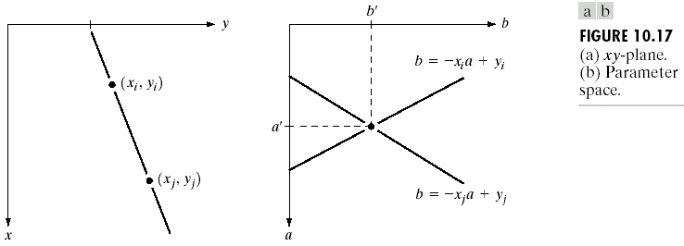
Global Processing via the Hough Transform

Slide 38
Global Processing via the Hough Transform
The computational attractiveness of the Hough transform arises from subdividing the parameter space into so-called accumulator cells, where (a_{max}, a_{min}) and (b_{max}, b_{min}) are the expected ranges of slope and intercept values.
The cell at coordinates (i, j), with accumulator value A(i,j), corresponds to the square associated with parameter space coordinates (a_{i},b_{j}).
Initially, these cells are set to zero.
For every points (x_{k}, y_{k}) in the image plane, we let the parameter a equal each of the allowed subdivision values on the a axis and solve for the corresponding b using the equation b=-x_{k}a +y_{k}.

Slide 39
Global Processing via the Hough Transform
The resulting b’s are then rounded off to the nearest allowed value in the b axis.
If a choice of a_{p} results in solution b_{q}, we let A(p,q)=A(p,q)+1.
At the end of the procedure, a value of Q in A(i,j) corresponds to Q points in the xy-plane lying on the line y=a_{i}x+b_{j}.
The number of subdivisions in the ab plane determines the accuracy of the colinearity of these points.

Slide 40
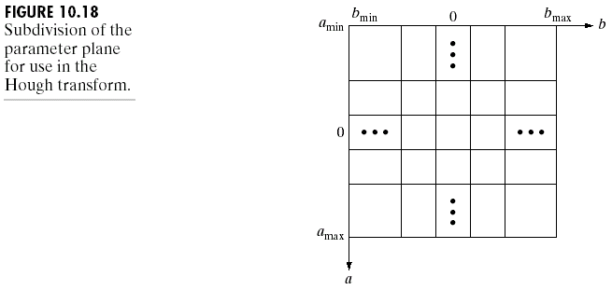
Global Processing via the Hough Transform

Slide 41
Global Processing via the Hough Transform
Subdividing the a axis into K increments gives, for every point (x_{k},y_{k}), K values of b corresponding to the K possible values of a. With n image points, this method involves nK computations.
A problem with using the equation y=ax+b to represent a line is that the slope approaches infinity as the line approaches the vertical. One way around this difficulty is to use the normal representation of a line x cos θ + y sin θ = ρ.

Slide 42
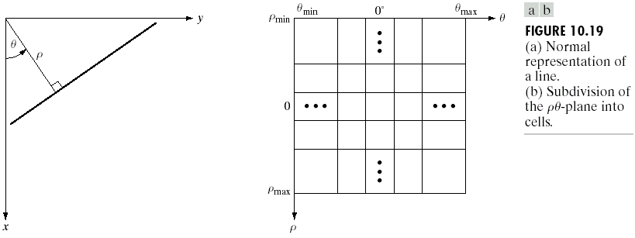
Global Processing via the Hough Transform
The range of angle θ is ±90°, measured with respect to the x axis. A horizontal line has θ=0 °, with ρ being equal to the positive x-intercept.

Slide 43
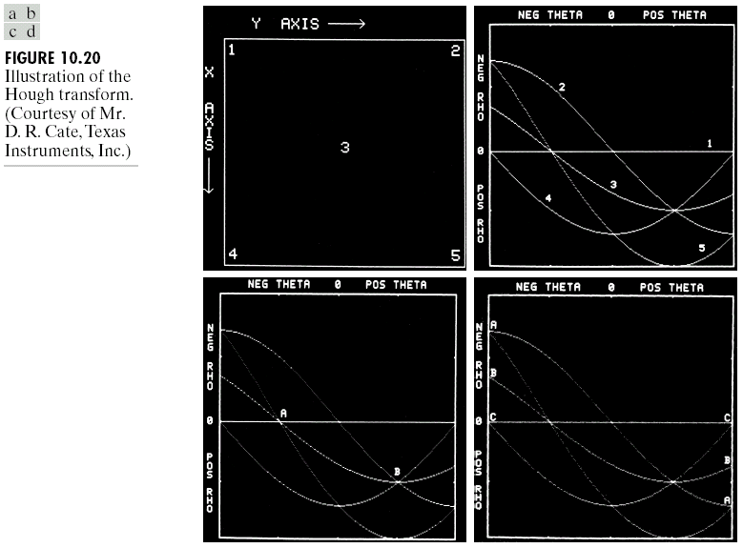
Global Processing via the Hough Transform

Slide 44
Global Processing via the Hough Transform
An approach based on the Hough transform to the edge linking problem is :
  Compute the gradient of an image and threshold it to obtain a binary image.
  Specify subdivisions in the ρθ plane
  Examine the counts of the accumulator cells for high pixel concentrations
  Examine the relationship (principally for continuity) between pixels in a chosen cells.

Slide 45
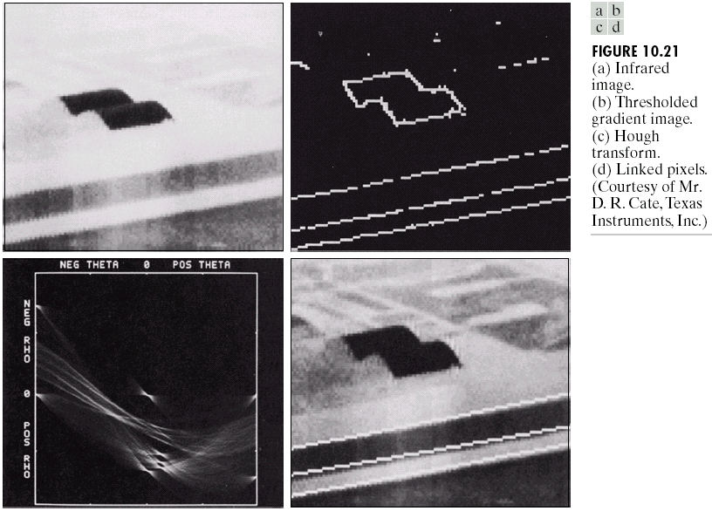
Global Processing via the Hough Transform

Slide 46
Global Processing via Graph Theoretic Techniques
We’ll discuss a global approach for edge detection and linking based on representing edge segments in the form of a graph and searching the graph for low cost paths that correspond to significant edges.
The representation provides a rugged approach that performs well in the presence of noise. But, the procedure is more complicated and requires more processing time than the methods discussed so far.

Slide 47
Global Processing via Graph Theoretic Techniques
A graph G=(N,U) is a finite, nonempty set of nodes N, together with a set U of unordered pairs of distinct elements of N.
Each pair (ni,nj) of U is called an arc.
A graph in which the arcs are directed is called a directed graph.
If an arc is directed from node ni to node nj, then nj is said to be successor of the parent node ni.
The process of identifying the successors of a node is called expansion of the node.
In each graph we define levels, such that level 0 consist of a single node, called the start or root node, and the nodes in the last level are called goal nodes.

Slide 48
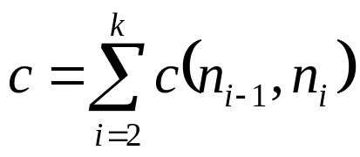
Global Processing via Graph Theoretic Techniques
A cost c(ni,nj) can be associated with every arc (ni,nj).
A sequence of nodes n1, n2, …,nk with each node ni being a sucessor of node ni-1, is called a path from n1 to nk. The cost of the entire path is :

Slide 49
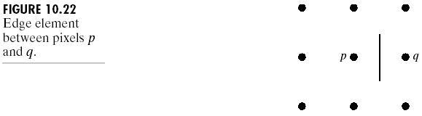
Global Processing via Graph Theoretic Techniques
An edge element is defined as the boundary between two pixels p and q, such that p and q are 4-neighbors.
Edge elements are identified by the xy-coordinates of points p and q. In other words, the edge element is defined by the pairs (xp,yp)(xq,yq).
An edge is a sequence of connected edge elements.

Slide 50
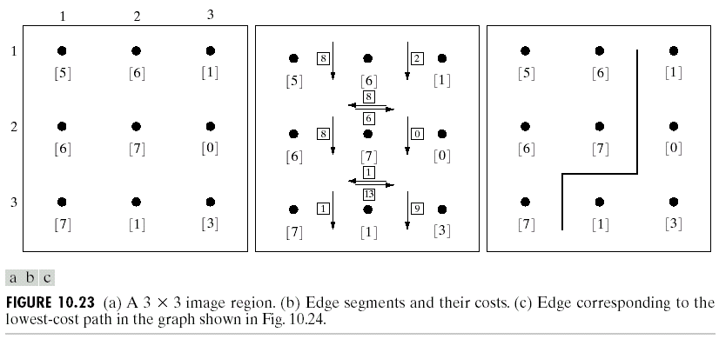
Global Processing via Graph Theoretic Techniques
Each edge element, defined by pixels p and q, has a cost defined as :
c(p,q)=H-[f(p)-f(q)]
where H is the highest gray-level value in image, and f(p) and f(q) are the gray level values of p and q.
By convention, the point p is on the right hand side of the direction of travel along edge elements.
To simplify the discussion, we assume that edges start in the top row and terminate in the last row.

Slide 51
Global Processing via Graph Theoretic Techniques
Let r(n) be an estimate of the cost of a minimum-cost path from the start node s to a goal node, where the path is constrained to go through n. This cost can be expressed as the estimate of the cost of a minimum-cost path from s to n plus an estimate of the cost of that path from n to a goal node; that is : r(n)=g(n)+h(n)
g(n) can be chosen as the lowest-cost path from s to n found so far
h(n) is obtained by using any available heuristic information (such as expanding only certain nodes based on previous cost in getting to that node).

Slide 52
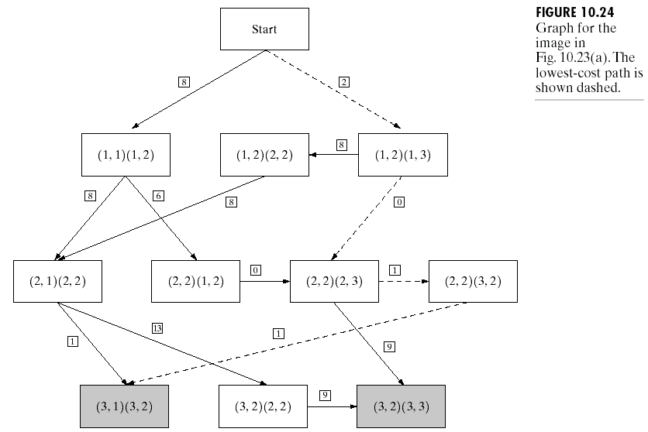
Global Processing via Graph Theoretic Techniques

Slide 53
Global Processing via Graph Theoretic Techniques
The approach is to sacrifice optimality for the sake of speed, and the following represents a heuristic approach for performing a graph search to find a minimum-cost path :
Mark the start node OPEN and set g(s)=0.
If no node is OPEN exit with failure; otherwise continue.
Mark CLOSED the OPEN node n whose estimate r(n) computed using r(n)=g(n)+h(n) is smallest.
If n is a goal node, exit with the solution path obtained by tracing back through the pointers; otherwise, continue.
Expand node n, generating all of its successors. (If there are no successors go to step 2)
If a successor ni is not marked, set
r(ni)=g(n)+c(n,ni)
Mark it OPEN, and direct pointers from it back to n.
7. If a successor ni is marked CLOSE or OPEN, update its value by letting
g’(ni)=min[g(ni), g(n)+c(n,ni)]
Mark OPEN those CLOSED successors whose g’ values were thus lowered and redirect to n the pointers from all nodes whose g’ values were lowered. Go to step 2.

Slide 54
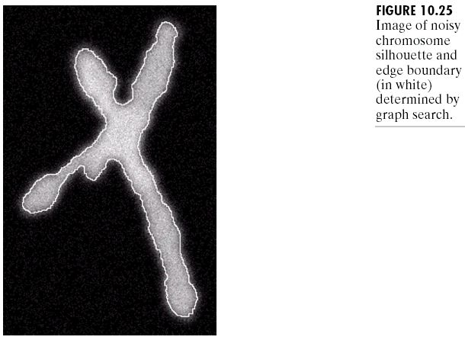
Global Processing via Graph Theoretic Techniques

Slide 55
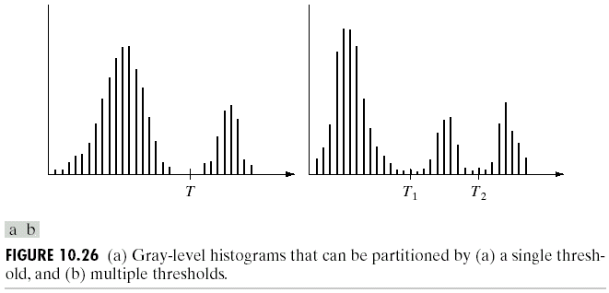
Thresholding
Suppose that the gray level histogram in left corresponds to an image f(x,y), composed of light objects on a dark background, in a such a way that object and background pixels have gray levels grouped into two dominant modes.
One obvious way to extract the objects from the background is to select a threshold T that separates these modes.
Then any point (x,y) for which f(x,y)>T is called an object point; otherwise, the point is called a background point.

Slide 56
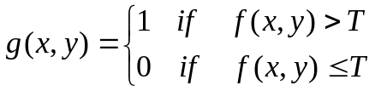
Thresholding
Figure in right shows a slightly more general case, where three dominant modes characterize the image histogram (for example, two types of light objects on a dark background).
Here, multilevel thresholding classifies a point (x,y) as belonging to one object class if T1<f(x,y)≤T2, to the other object class if f(x,y)>T2, and to the background if f(x,y) ≤T1.
Thresholding may be viewed as an operation that involves tests against a function T of the form :
T = T[x,y,p(x,y),f(x,y)]
where f(x,y) is the gray level of point (x,y) and p(x,y) denotes some local property of this point – for example, the average gray level of a neighborhood centered on (x,y).
A threshold image g(x,y) is defined as :
Pixels labeled 1 (or any other convenient gray level) correspond to objects, whereas pixels labeled 0 (or any other gray level not assigned to objects) correspond to the background.

Slide 57
Thresholding
When T depends only on f(x,y) the threshold is called global.
If T depends on both f(x,y) and p(x,y), the threshold is called local.
If T depends on the spatial coordinates x and y, the threshold is called dynamic or adaptive.

Slide 58
Basic Global Thresholding
The simplest of all thresholding techniques is to partition the image histogram by using a single global threshold T. Segmentation is then accomplished by scanning the image pixel by pixel and labeling each pixel as object or background, depending on whether the gray level of that pixel is greater or less than the value of T. The success of this method depends entirely on how well the histogram can be partitioned.

Slide 59
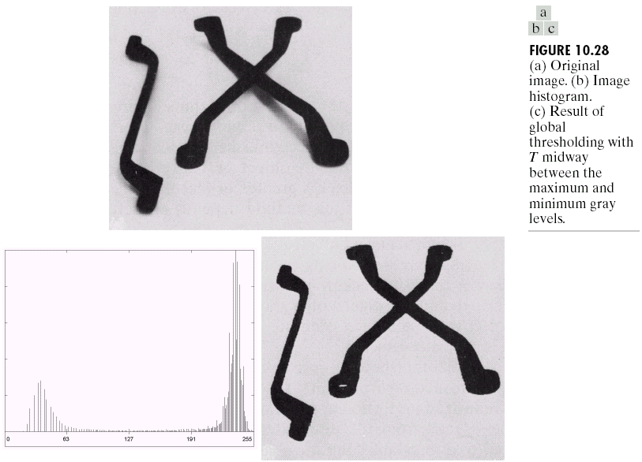
Basic Global Thresholding

Slide 60
Basic Global Thresholding
The type of global thresholding can be expected to be successful in highly controlled environment. One of the areas in which this often is possible is in industrial inspection applications, where control of illumination usually is feasible.
The threshold in the preceding example was specified by using a heuristic approach, based on visual inspection of the histogram.
The following algorithm can be used to obtain T automatically :
  Select an initial estimate for T.
  Segment the image using T. This will produce two groups of pixels: G1 consisting of all pixels with gray level values > T and G2 consisting of pixels with values ≤ T.
  Compute the average gray level values u1 and u2 for the pixels in regions G1 and G2.
  Compute a new threshold value : T= ½ (u1+u2)
  Repeat steps 2 through 4 until the difference in T in successive iterations is smaller than s predefined parameter T0.

Slide 61
Basic Global Thresholding
When the background and the object occupy comparable areas in the image, a good initial value for T is the average gray level of the image.
When objects are small compared to the area occupied by the background (or vise versa), then one group of pixels will dominate the histogram and a value midway between the maximum and the minimum gray levels is a good initial choice.

Slide 62
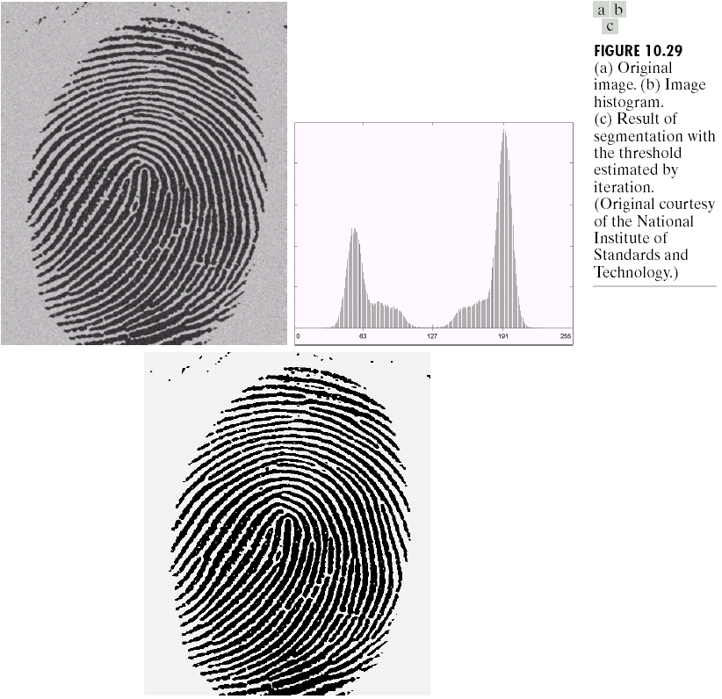
Basic Global Thresholding
Application of the iterative algorithm resulted in a value of 125.4 after three iteration starting with the average gray level and T0=0. The result obtained using T=125 to segment the original image.

Slide 63
Basic Adaptive Thresholding
Imaging factors such as uneven illumination can transform a perfectly segmentable histogram into a histogram that cannot be partitioned effectively by a single global threshold.
An approach for handling such a situation is to divide the original image into subimages and then utilize a different threshold to segment each subimage.
The key issues in this approach are how to subdivide the image and how to estimate the threshold for each resulting image.
Since the threshold used for each pixel depends on the location of the pixel in terms of the subimages, this type of thresholding is adaptive.

Slide 64
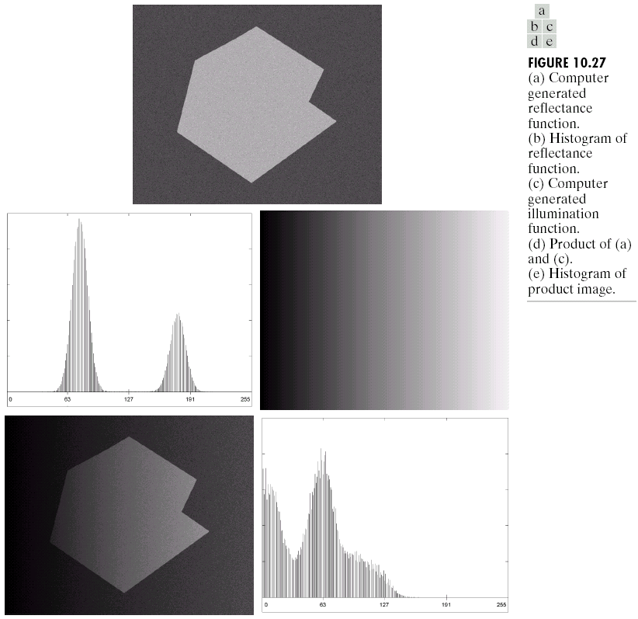
Basic Adaptive Thresholding

Slide 65
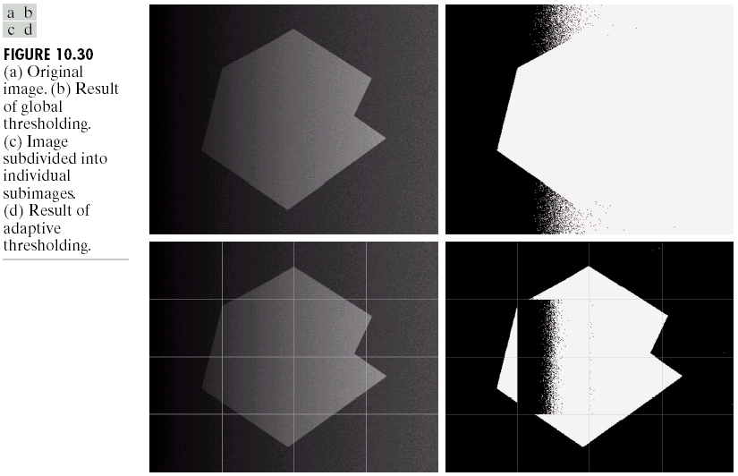
Basic Adaptive Thresholding

Slide 66
Basic Adaptive Thresholding
All the subimages that did not contain a boundary between object and background had variances of less than 75.
All subimages containing boundaries had variances in excess 100.
Each subimage with variance greater than 100 was segmented with a threshold computed for that subimage using the algorithm discussed in the previous section. The initial value for T in each case was selected as the point midway between the minimum and maximum gray levels in the subimage.
All subimages with variance less than 100 were treated as one composite image, which was segmented using a single threshold estimated using the same algorithm.

Slide 67
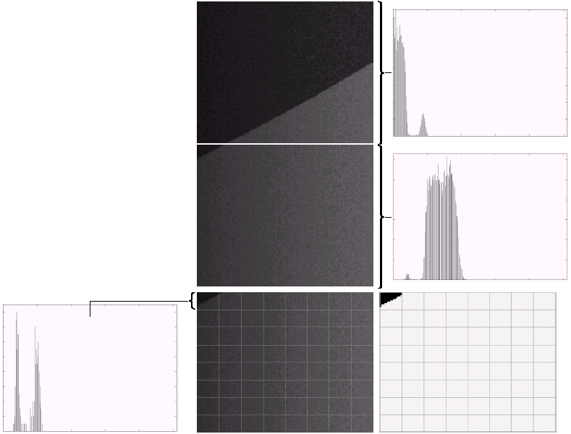
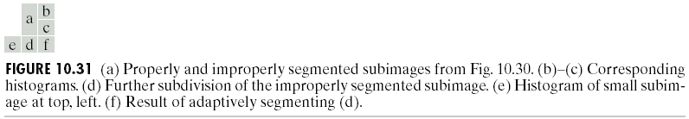
Basic Adaptive Thresholding

Slide 68
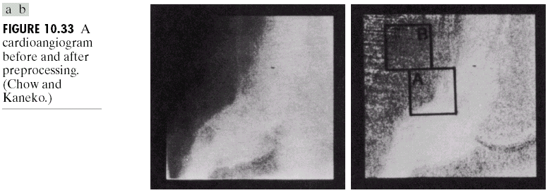
Optimal Global and Adaptive Thresholding
Optimal threshold is threshold that produce the minimum average segmentation error.
The following is one of the earliest examples of segmentation by optimum thresholding in image processing.
The general problem is to outline automatically the boundaries of heart ventricles in cardioangiograms (X-ray images of a heart that has been injected with a contrast medium).

Slide 69
Optimal Global and Adaptive Thresholding
Prior to segmentation, all images were preprocessed as follows :
  Each pixel was mapped with a log function to counter exponential effects caused by radioactive absorption.
  An image obtained before application of the contrast medium was subtracted from each image captured after the medium was injected in order to remove the spinal column present in both images.
  Several angiograms were summed in order to reduce random noise.

Slide 70
Optimal Global and Adaptive Thresholding
In order to compute the optimal thresholds, image was subdivided into 49 regions by placing a 7 x 7 grid with 50% overlap over each image (image is of size 256 x 256 pixels). Each of the 49 resulting overlapped regions contained 64 x 64 pixels.
After all 49 histograms were computed, a test of bimodality was performed to reject the unimodal histograms.

Slide 71
Region Based Segmentation
The objective of segmentation is to partition an image into regions.
We approach this problem :
  By finding boundaries between regions based on discontinuities in gray levels
  Via thresholds based on the distribution of pixel properties, such as gray levels
  By finding the regions directly

Slide 72
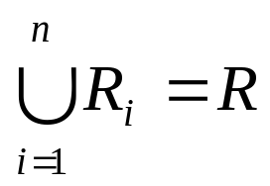
Region Based Segmentation
Let R represent the entire image region. We may view segmentation as a process that partitions R into n subregions, R1, R2, …, Rn, such that :
Ri is a connected region, i=1,2,…,n
Ri ∩ Rj = ∅ for all i and j, i ≠ j
P(Ri)=TRUE for i=1,2,…,n
P(Ri ∪ Rj)=FALSE for i ≠ j

